Slide 1

Encouraging Difference
Through Communication Training
Jessica Siller

Slide 2


Introduction
A more diverse workforce will:
Lift morale
Enhance Productivity
Bring larger access to new portions of the marketplace
Why encouraging differences matters
Siller

Slide 3

Objectives
Examining Job Postings with a Critical Eye
The importance of diversity
Critical Review of job posting
How the job posting aligns with the company mission statement
Do the job posting and mission statement support diversity
Siller

Slide 4

Groundworks
Management Job Posting
Siller

Slide 5
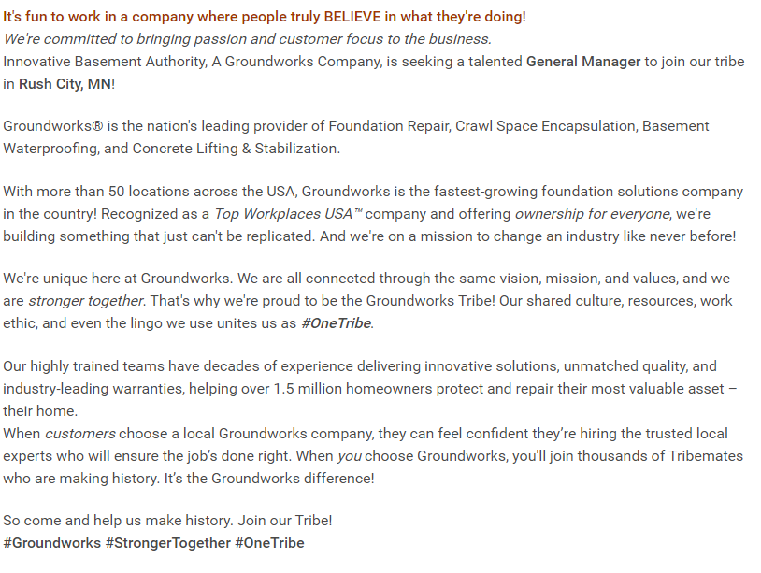
Critical Language Review
Groundworks presents a gender neutral posting in what they are looking for in a management member.
Groundworks Job Posting
Mission, Vision, Core Values
To protect, repair, and improve our customers’ greatest asset – their home.
Building the nations leading foundation and water management solutions company.
We work until it’s done right. Build open and honest relationships with communication. Deliver quality through great service. Embrace and drive growth. Everyone puts their boots on the same way. Embrace Meritocracy.
Groundworks Job Posting
Groundworks Mission Statement
Siller
Notes:
While the groundworks post is gender neutral, as well as the mission statement. Many people still consider management roles in construction industries to be male dominated.

Slide 6
Groundworks Culture Analysis
Corporate Culture Analysis
Does the job listing acknowledge difference?
  If yes, how so? Is the difference affirmed or discounted in some way?
  Difference is embraced by the inclusion of wording such as everyone, and stronger together
  Does the job listing identify communication practices, standards, or expectations within the organization?
  The job listing does not exhibit the communication practices or expectations of the company.
  What does the corporate statement tell a potential worker about the organizational culture or work climate?
  The mission, value and core value statements tell the potential worker that communication and differences are embraced.
Evaluation
What highlights or potentially the best-selling points of the job listing?
The highlight of this job posting is the lack of specified orientation language, gender neutral and open to all who possess the skills sought.
Suggested Revisions
Less usage of terms such as family, as many markets are moving away from such terminology.
Siller

Slide 7

Safe Streets
Management Job Posting
Siller

Slide 8
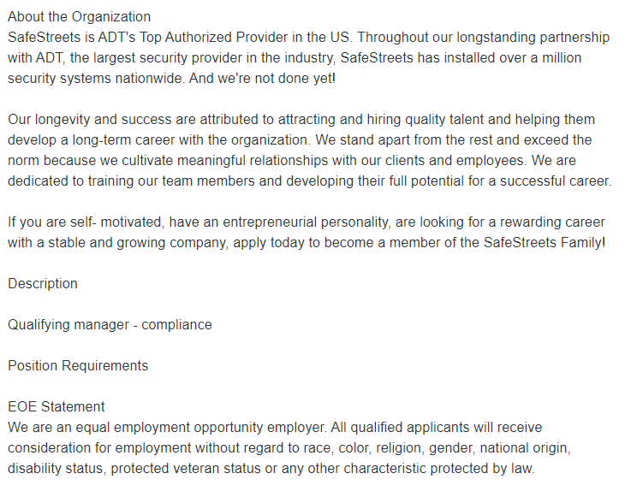
Critical Language Review
Safe Streets utilized the EOE statement in their job posting
Safe Streets USA Job Posting
Mission Statement
“We exist to enhance the quality of life of people everywhere through protecting what they value most”
Safe Streets job posting
Safe Streets Mission Statement
Siller
Notes:
The language in the posting is gender neutral, and the company is showcasing they are compliant with EOE by including the statement, but could do better by using more embracing language. The lack of information regarding how they treat employees in both the posting and mission statement is worrisome to those who are seeking inclusion.

Slide 9
Safe Streets Culture Analysis
Corporate Culture Analysis
Does the job listing acknowledge difference?
  If yes, how so? Is the difference affirmed or discounted in some way?
  Gender neutral terminology, but the EOE statement feels disingenuous
  Does the job listing identify communication practices, standards, or expectations within the organization?
  No mention of communication expectations are in the posting
  What does the corporate statement tell a potential worker about the organizational culture or work climate?
  The statement focuses on the potential customer, and not on the potential employee.
Evaluation
What highlights or potentially the best-selling points of the job listing?
No specified orientation or gender specific language
Suggested Revisions
Less use of the term family, more detail regarding the position itself. Terms such as self-motivating and entrepreneurial spirit make it appear the job position has no definition.
Siller

Slide 10
Kroger
Management Job Posting
Siller

Slide 11
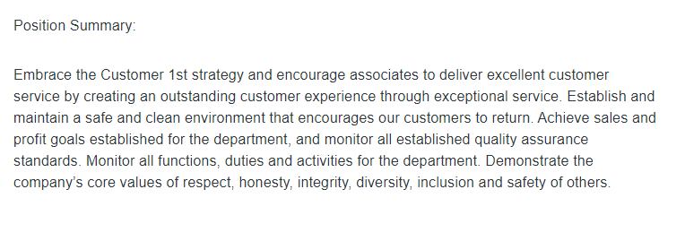
Critical Language Review
Kroger used key terms such as embracing, and the core values in the posting.
Kroger Job Posting
Kroger Values
Honesty
Integrity
Respect
Diversity
Safety
Inclusion
Kroger Job Posting
Kroger Values
Siller
Notes:
Kroger’s use of key values, allows people to realize they are capable of embracing differences

Slide 12
Kroger Culture Analysis
Corporate Culture Analysis
Does the job listing acknowledge difference?
  If yes, how so? Is the difference affirmed or discounted in some way?
  Gender neutral terms, provides excellent outline of what leadership qualities they expect.
  Does the job listing identify communication practices, standards, or expectations within the organization?
  The listing showcased the communication and leadership expectations of the company.
  What does the corporate statement tell a potential worker about the organizational culture or work climate?
  The values of the company are honesty, integrity, respect, diversity, safety and inclusion. The values presented showcase that Kroger is making a valiant effort in ensuring their company is inclusive to all
Evaluation
What highlights or potentially the best-selling points of the job listing?
The job listing clearly outlines the expectations and leadership qualities they are looking for.
Suggested Revisions
Expand upon what “effective communication skills” means.
Siller

Slide 13



Thank You
Jessica Siller
Siller.Jessica.b@gmail.com
Siller

Slide 14
References
Allen, B. J. (2011) Difference matters: Communicating social identity. Long Grove, IL: Waveland Press. (2nd Ed.), Chapter 1.
Groundworks:
  https://www.groundworks.com/about-us/mission/
  https://groundworks.wd1.myworkdayjobs.com/en-US/Groundworks/job/General-Manager_JR104578-1
Safe Streets
  https://www.safestreets.com/about-us/
  Safe Streets Job Posting
Kroger
  https://www.thekrogerco.com/about-kroger/
  Kroger Job Posting
Siller

